Slide 1
GOLD PRICE PREDICTION SYSTEM
TEAM MEMBERS
RA2111031010058 YASHI JAIN
RA2111031010056 YASH KUMAR
RA2111031010046 PRANAV KHATTAR

Slide 2
ABSTRACT
We predict future gold rates supported twenty two market variables victimization machine learning technique . One machine learning algorithm, random forest regression were used in analyzing these knowledge.
Historically, gold was used for supporting trade transactions around the world besides alternative modes of payment.
Various states maintained and increased their gold reserves and were recognized as rich and progressive states. In present times, precious metals like gold area unit control with central banks of all countries to make sure re-payment of foreign debts, and conjointly to control inflation.
Moreover, it conjointly reflects the money strength of the country.
Besides government agencies, varied transnational firms and people have conjointly invested with in gold reserves

Slide 3
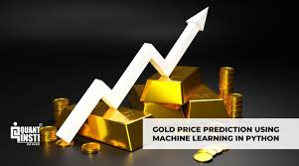
INTRODUCTION
Investing in gold has developed over a amount of your time in conventional forms by buying jewellery or through modern strategies, either by buying gold coins and bars (which area unit already accessible in scheduled banks).Historically, gold had been used as a sort of currency in various components of the planet as well as USA . In recent times also, gold has maintained its worth and has been used as a means for assessing the monetary strength of a rustic.

Slide 4
FEATURES
Data collection: The first step in building a machine learning model is to collect relevant data. In the case of gold price prediction, data can be obtained from various sources, including financial news websites, government reports, and social media.
Data preparation and cleaning: Following data collection, the data must be cleaned. This include eliminating duplicates, filling in blanks, and formatting the data appropriately for analysis.
Feature selection and engineering: Machine learning algorithms require features to make predictions. In the case of gold price prediction, relevant features may include economic indicators such as inflation rates, interest rates, and GDP, as well as market-specific factors such as gold production, gold demand, and geopolitical events.

Slide 5
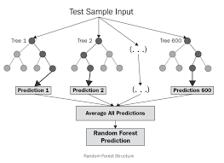
Model training: Utilising previous data, the machine learning model must be trained next. To attain the best performance, this entails choosing the right algorithm and optimising its settings.
Evaluation of the model: After the model has been trained, it needs to be assessed to see how well it performs. The usual method for doing this is to contrast the model's predictions with real gold prices.
The model must be used to produce predictions on new data in a real-world scenario as the last stage before deployment

Slide 6
CHALLENGES
1. Quality of data
Financial data is often noisy and subject to errors, which can affect the accuracy of machine learning models. Therefore, it is essential to preprocess and clean the data before feeding it into the machine learning algorithm.
2. Domain expertise
It is important to have a thorough understanding of the factors that affect gold prices to select relevant features and engineer new ones. Lack of domain expertise can result in choosing irrelevant features or engineering inappropriate ones, leading to inaccurate predictions.
3. Overfitting
Overfitting occurs when a machine learning model learns the training data too well and performs poorly on new, unseen data. This can be a problem in the case of gold price prediction because the relationships between factors affecting gold prices can be complex and difficult to capture accurately.

Slide 7
Real-Time Applications
Despite the challenges, there are several real-time applications of machine learning for gold price prediction. Some of the key applications include:
Investment decision-making
Machine learning algorithms can provide investors with valuable insights into gold price trends and help them make informed investment decisions. Investors may remain ahead of the curve and make profitable investing decisions by utilising real-time data and powerful machine learning models.

Slide 8
Risk management
When making gold investment decisions, risk can be evaluated and managed using machine learning. Machine learning algorithms can assist investors in reducing risk and losses by examining a variety of data sources and locating potential risk factors.
Trading plans
Trading plans based on projections of the price of gold can be created using machine learning algorithms. Machine learning algorithms can assist investors in creating profitable trading strategies by looking at past data and seeing patterns.
Forecasting
Machine learning can be used to forecast gold prices over different time horizons. By using real-time data and sophisticated machine learning models, investors can develop accurate and reliable forecasts of gold prices, enabling them to make informed investment decisions.

Slide 9
LITERATURE SURVEY
Gold is that the alone and that retains its worth even through the political and economic. downturn. The gold values unit of measurement usually directly connected to different resources. Future gold worth forecast is that the investors' alert mechanism thanks to unpredictable market risk.
Therefore, precise prognostication of gold prices is needed to predict the market patterns. several machine intelligent techniques for gold prognostication applications square measure noted over the past decade.
The link between gold value and costs of different commodities particularly petroleum has conjointly been extensively studied.
However the results from these studies square measure found to be contradicting. a number of the studies on the factors influencing gold value and numerous techniques used for learning these relationships.

Slide 10
Some of the research papers on Price prediction are listed below:
1. Stock Closing Price Prediction
This research based on accurate prediction of stock market returns is a very challenging task due to volatile and non-linear nature of the financial stock markets. With the introduction of artificial intelligence and increased computational capabilities, programmed methods of prediction have proved to be more efficient in predicting stock prices. In this work, Artificial Neural Network and Random Forest techniques have been utilized for predicting the next day closing price for five companies belonging to different sectors of

Slide 11
2. Bitcoin Price Prediction
In this paper, we use the LSTM version of Recurrent Neural Networks, pricing for Bitcoin. To develop a better understanding of its price influence and a common view of this good invention, we first give a brief overview of Bitcoin again economics House Price Prediction: This research is carried out to analyze the relevant attributes and the most efficient models to forecast the house prices. The findings of this analysis verified the use of the Artificial Neural Network, Support Vector Regression and XG Boost as the most efficient models compared to others. Moreover, our findings also suggest that locational attributes and structural attributes are prominent factors in predicting house prices. This study will be of tremendous benefit, especially to housing developers and researchers, to ascertain the most significant attributes to determine house prices and to acknowledge the best machine learning model to be used to conduct a study in this field. Used Car Price Prediction: This research based on prediction price of used cars by using Machine Learning Algorithms such as Lasso Regression, Multiple Regression and Regression trees, we will try to develop a statistical model which will be able to predict the price of a used car, based on previous consumer data and a given set of features. We will also be comparing the prediction accuracy of these models to determine the optimal one.

Slide 12
PROBLEM STATEMENT
From the above comprehensive literature review on different prediction methods in business applications utilizing analytical intelligent techniques throughout the past decades, it has been noted that the following problems are found when carrying out prediction processes for the business applications considered – foreign exchange rate prediction, stock market price prediction, gold price prediction
1)Unattained Scalability
2)Premature Network Convergence model
3)Trapping ourselves in local and global optima
4)Stilling
5)Large prognostic bias
6)Overlapping computing energy
7)The computational load of the algorithms increased
8)No assurance on system's interpretability

Slide 13
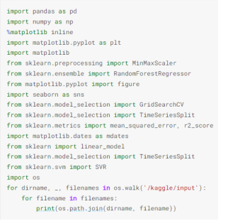
RESULTS AND SCREENSHORTS
1. IMPORTING LIBRARIES

Slide 14
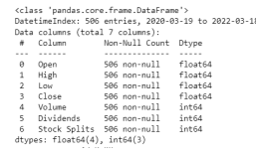
2. DATA UNDERSTANDING

Slide 15
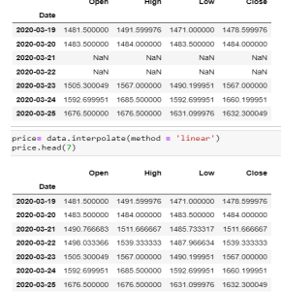
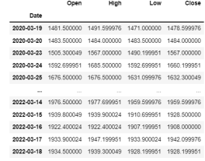
3. DATA PRE-PROCESSING

Slide 16
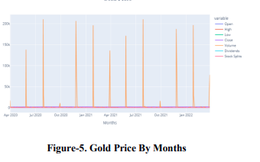
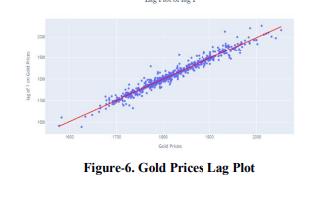
4. DATA VISUALIZATION
Data visualization is the graphical representation of information and data. By using visual elements like charts, graphs, and maps, data visualization tools provide an accessible way to see and understand trends, outliers, and patterns in data.

Slide 17
EXISTING DATASET
Data for this study is collected from (kaggle.com) Dec 2011 to September 2016 from numerous sources. information for attributes, such as Oil worth, NYSE, normal and Poor’s (S&P) five hundred index, US Bond rates (10 years), EuroUSD exchange rates were gathered.
Data of the many government central banks and 5 giant companies that have invested with Brobdingnagian amounts in gold have conjointly been collected. worth of precious metals throughout this era is also enclosed within the analysis.
Table I lists the net sources from that this information was extracted[9]. Table II lists of these attributes. The price of gold that we tend to try to predict is taken in US Dollar,plenty of cleansing and preprocessing was performed on the dataset, the matter of missing values was handled in appropriate manner to finish the dataset.
Gold costs amendment on everyday and are full of major world events. Current gold rates ar a lot of beyond a few years past.

Slide 18
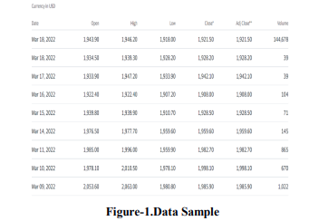

Slide 19
PROPOSED METHODOLOGY
We use 2 milliliter models, particularly Random Forest, and linear regression. Random forest is a Supervised Machine Learning Algorithm that is used widely in Classification and Regression problems.
In addition to the input and output layers, they carries with it one or more hidden layers of neurons that try and learn non-linear decision boundaries that separate totally different categories of information.
It can also be accustomed predict continuous valued attributes like gold costs in our case. Fig. four depicts a sample ANN.
Linear regression (LR) is AN approach utilized in statistics to model relationship between dependent (class variable) and one or additional freelance variables (attributes). regression can be used for predicting continuous valued attribute.
We use the implementation of LR and ANN that's provided by RapidMiner tool. each models area unit optimized exploitation the RMSE performance live. The specialists then collect, pick, plan, preprocess and convert this information.

Slide 20
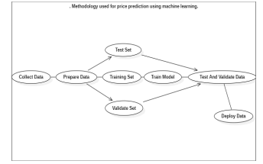
A model that predicts costs at the utmost preciseness rate would be chosen to drive a tool or program and therefore the worth prediction perform system would possibly appear as if this:
1)Statement on drawback.
2)Knowing the peculiarities of economies. respondent the question: What variables square measure poignant artefact / product / service prices?
3)Gathering, preparing, and preprocessing information.
4)Testing and modelling.
5)Deploying a model into a code or application Machine learning algorithms square measure oftentimes classified as supervised or unsupervised.

Slide 21
CONCLUSION
This study by using machine learning algorithms to accurately predict the gold prices and when to sell them and purchase them. This research was done in order to clarify the gold ETF price predictions using machine learning using Python. The research was carried out for data between April 2020 and Jan 2022.
The results on proposed model is as per the following:
1)It is concluded that machine learning algorithms with Random Forest analysis are very useful in gold price prediction.
2)It is concluded that, the model's R-square is 97 percent. R-squared is usually 0 to 100 per cent. A score close to 100 per cent indicates that the Gold ETF prices are well explained by the given model.
3)Results show that proposed Random forest method-machine learning beats customary and current predicting models

Slide 22
REFERENCES
1.Xiaohui Yang, "The Prediction of Gold Price Using ARIMA Model", 2nd International Conference on Social Science, Public Health and Education 2019.
2. Manjula K. A., Karthikeyan P, "Gold Price Prediction using Ensemble based Machine Learning Techniques", Third International Conference on Trends in Electronics and Informatics, 2019.
3. Mrs. B. Kishori 1, V. Preethi, "Gold Price forecasting using ARIMA Model", International Journal of Research, 2018.
4. R. Hafezi* , A. N. Akhavan, "Forecasting Gold Price Changes: Application of an Equipped Artificial Neural Network", AUT Journal of Modeling and Simulation, 2018.
5. Xiaohui Yang, "The Prediction of Gold Price Using ARIMA Model", 2nd International Conference on Social Science, Public Health and Education (SSPHE 2018).
6. Shian-Chang Huang and Cheng-Feng Wu, Energy Commodity Price Forecasting with Deep Multiple Kernel Learning, MDPI Journal, 2018.
7.Wedad Ahmed Al-Dhuraibi and Jauhar Ali, "Using Classification Techniques to Predict Gold Price Movement", 4th International Conference on Computer and Technology Applications, 2018.

Slide 23
THANK YOU

